Slide 1
CS2422 Assembly Language & System Programming
December 25, 2003

Slide 2
Today’s Topics
Implementation Examples
  MASM Macro Processor
  ANSI C Macro Language
  The ELENA Macro Processor

Slide 3
Study Guide
Section 4.4

Slide 4
Macro-Assembler
Advantage
  Reduce 1 pass
  Share same data structure
Disadvantage
  More complex

Slide 5
Pass 1
READ
Search
(Pseudo-Op Table)
Pass 2
R
Type?
Search NAMTAB
(Macro Name Table)
MACRO
Define
Process
pseudo-ops
Search
(Machine Op Table)
R
R
MACRO
Expand
Process machine instruction
R
R

Slide 6
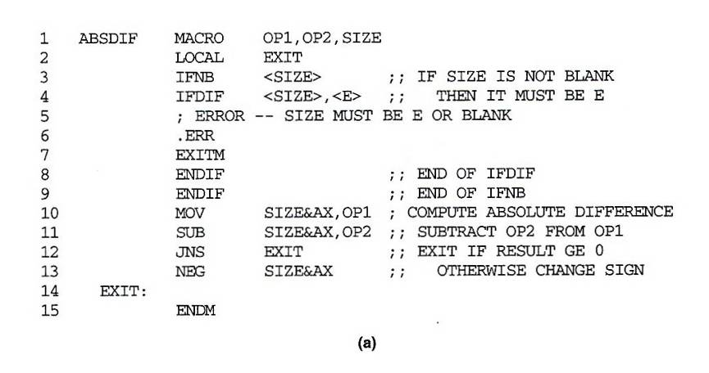
MASM Macro Processor (1/3)
Examples of MASM macro and conditional statements

Slide 7
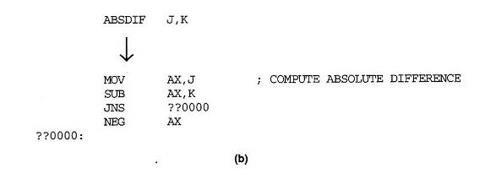
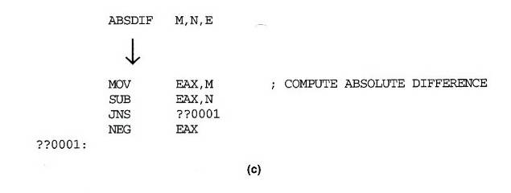
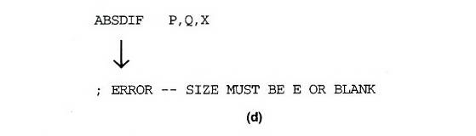
MASM Macro Processor (2/3)

Slide 8
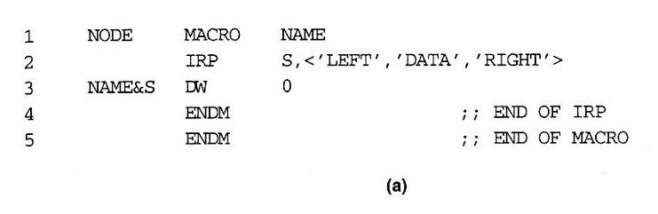
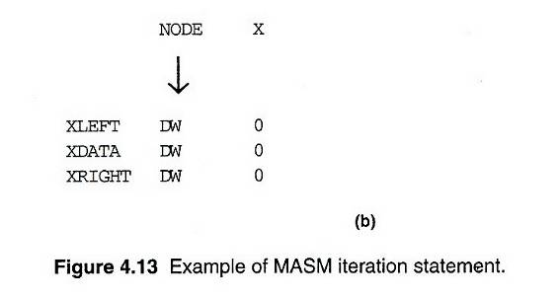
MASM Macro Processor (3/3)
Example of MASM iteration statement

Slide 9
ANSI C Macro Language (1/3)
Simple examples:
  #define NULL 0
  #define EOF (-1)
  #define EQ ==
Macro defined with parameters
  #define ABSDIFF( X, Y ) ( (X) > (Y) ? (X) – (Y) : (Y) – (X) )
  ABSDIFF( I+1, J–5 ) ➔
  ( ( I+1) > (J-5) ? (I+1) : (J-5) : (J-5) – (I+1) )
  #define ABSDIFF( X, Y ) X > Y ? X – Y : Y – X
  ABSDIFF( 3+1, 10-8 ) ➔
  3 + 1 > 10 – 8 ? 3 + 1 – 10 – 8 : 10 – 8 – 3 + 1

Slide 10
ANSI C Macro Language (2/3)
Parameter substitutions are not performed within quoted strings
  #define DISPLAY(EXPR) printf( “EXPR = %d\n”, EXPR )
  DISPLAY( I*J+1 )
  printf( “EXPR = %d\n”, I*J+1 )
Special “stringizing” operator #
  #define DISPLAY(EXPR) printf( #EXPR “= %d\n”, EXPR )
  DISPLAY( I*J+1 )
  printf( “I*J+1” “ = %d\n”, I*J+1 )

Slide 11
ANSI C Macro Language (3/3)
Macro within macro
  DISPLAY( ABSDIFF( 3, 8 ) )
  → printf( “ABSDIFF( 3, 8 ) )” “= %d\n”, ABSDIFF( 3, 8 ) )
  → printf( “ABSDIFF( 3, 8 ) )” “= %d\n”,
  ( (3) > (8) ? (3) – (8) : (8) – (3) ) )
Conditional macro
  #ifnedf BUFFER_SIZE
  #define BUFFER_SIZE 1024
  #endif
  #define DEBUG 1
  …
  #if DEBUG == 1
  printf( … ); // debugging output
  #endif

Slide 12
General Purpose Macro Processor (1/2)
ELENA
  Software: Practice and Experience, Vol. 14, pp. 519-531, Jun. 1984
Macro definition
  Header:
    A sequence of keywords and parameter markers (%)
    At least one of the first two tokens in a macro header must be a keyword, not a parameter marker
  Body:
    The character & identifies a local label
    Macro time instruction (.SET, .IF .JUMP, .E)
    Macro time variables or labels (.)

Slide 13
General Purpose Macro Processor (2/2)
Macro invocation
  There is no single token that constitutes the macro “name”
  Constructing an index of all macro headers according to the keywords in the first two tokens of the header
  Example
    DEFINITION:
      %1 = %2 + %3
      ALPHA = BETA + GAMMA
      ADD %1 TO THE FIRST ELEMENT OF %2
      ADD 10 TO THE VALUE OF INDEX
    INVOCATION:
      DISPLAY TABLE
DISPLAY %1
%1 TABLE

Slide 14
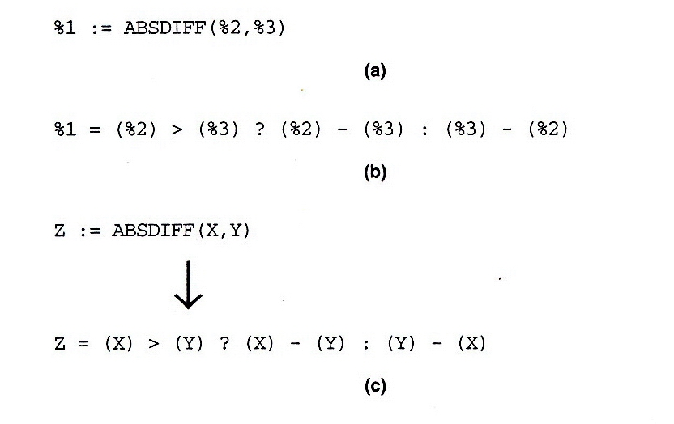
Fig. 4.14 (1/2)

Slide 15
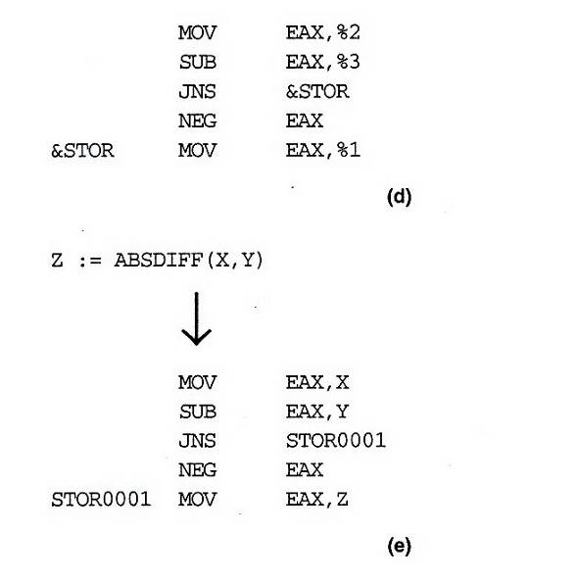
Fig. 4.14 (2/2)

Slide 16
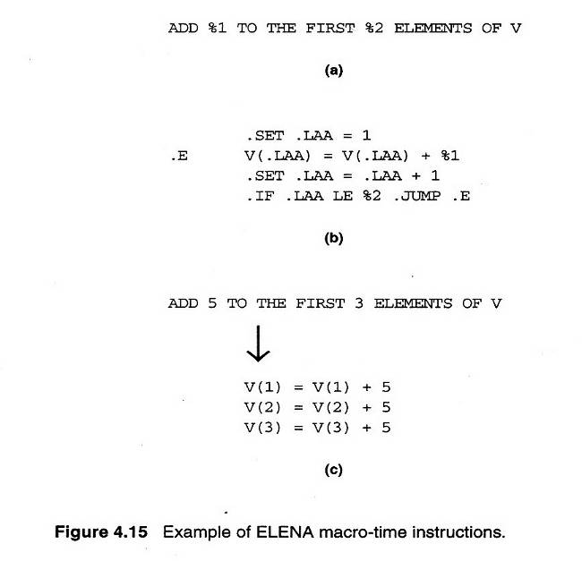
Fig. 4.15

